Slide 1





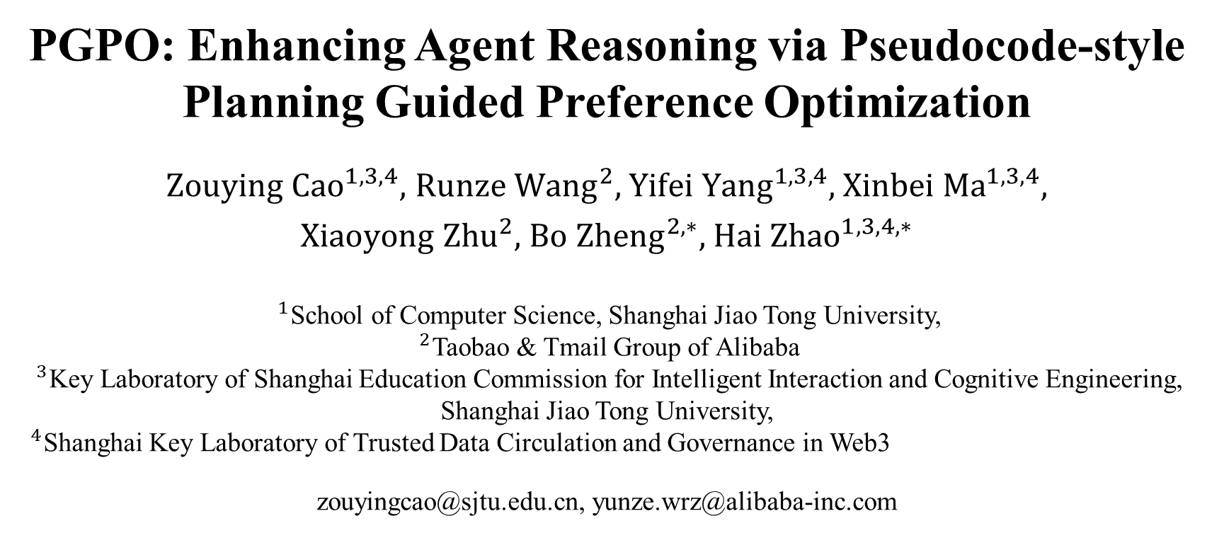
PGPO: Enhancing Agent Reasoning via Pseudocode-style Planning Guided Preference Optimization
${Zouying Cao}^{1,3, 4},$ ${\text{Runze} \text{Wang}}^{2},$ ${Yifei Yang}^{1,3,4},$ ${\text{Xinbei} \text{Ma}}^{1,3,4},$
${\text{Xiaoyong} \text{Zhu}}^{2},$ ${\text{Bo} \text{Zheng}}^{2,∗},$ ${Hai Zhao}^{1,3,4,∗}$
$^{1}$School of Computer Science, Shanghai Jiao Tong University,
$^{2}$Taobao & Tmail Group of Alibaba
$^{3}$Key Laboratory of Shanghai Education Commission for Intelligent Interaction and Cognitive Engineering, Shanghai Jiao Tong University,
$^{4}$Shanghai Key Laboratory of Trusted Data Circulation and Governance in Web3
zouyingcao@sjtu.edu.cn, yunze.wrz@alibaba-inc.com
https://arxiv.org/pdf/2506.01475
Notes:
Hi everyone, my name is Cao Zouying from Shanghai Jiao Tong University, China. Today, I will introduce our paper titled PGPO: Enhancing Agent Reasoning via Pseudocode-style Planning Guided Preference Optimization.

Slide 2
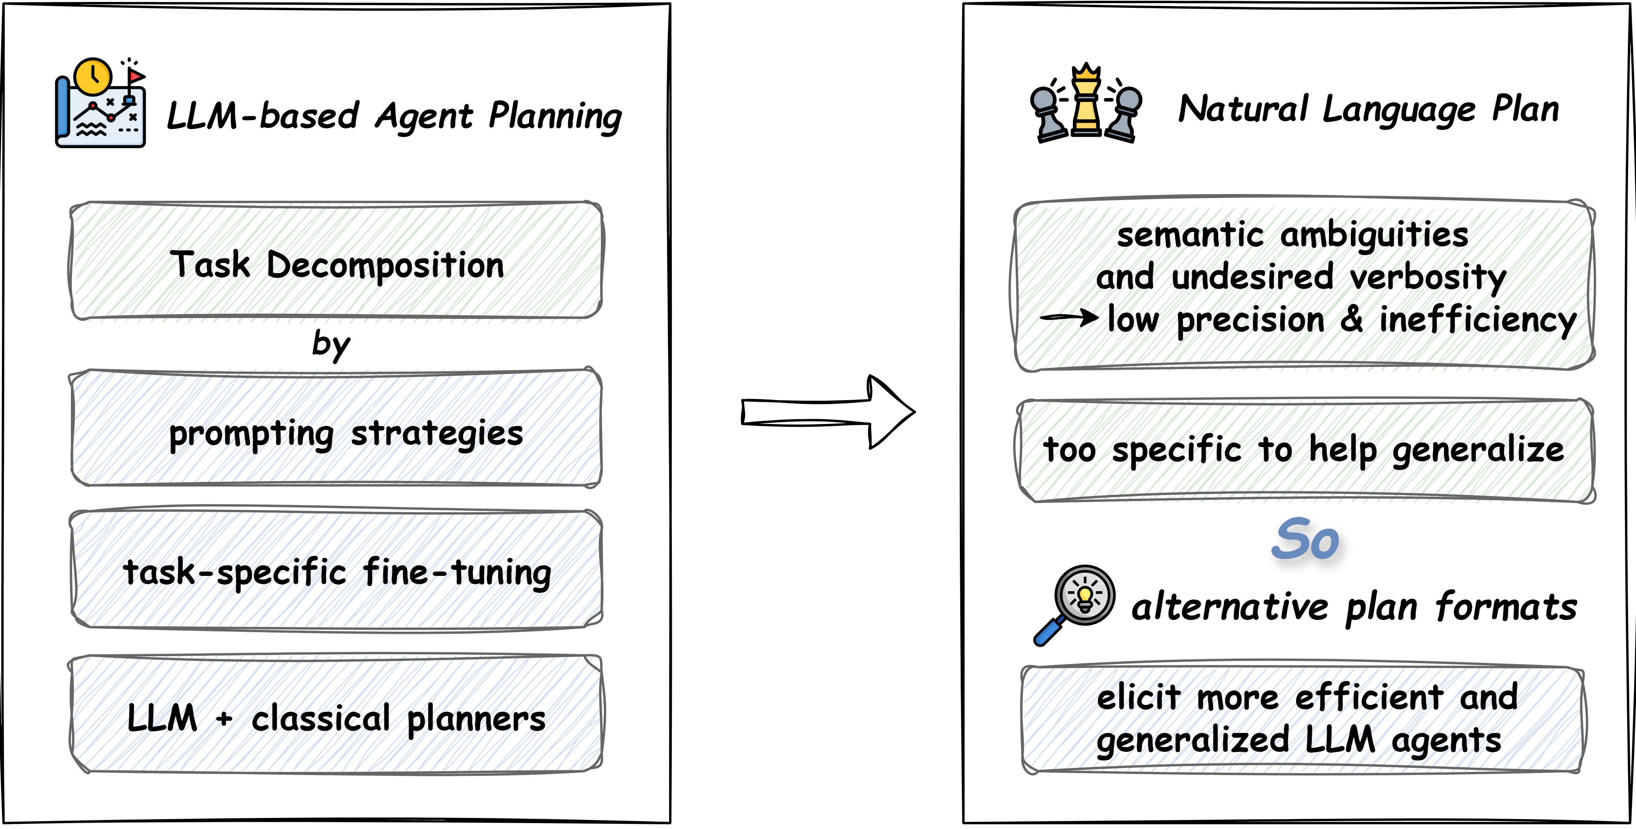
Introduction
Notes:
Recent advances in large language models have promoted the development of LLM agents. Planning serves as a critical component of agent reasoning, allowing agents to break down complex problems into manageable subtasks. By prompting strategies, task-specific fine-tuning or external classical planners, LLM agents are equipped with basic planning abilities.
Due to the dominance of natural language in agent reasoning, existing researches mainly focus on generating NL plans. However, semantic ambiguities and undesired verbosity in NL may not be beneficial to agent planning, leading to low precision and inefficiency. Meanwhile, NL plans are too specific to help LLM agents generalize to other unseen yet similar tasks.
Therefore, we explore whether alternative plan formats could elicit more efficient and generalized LLM agents.

Slide 3



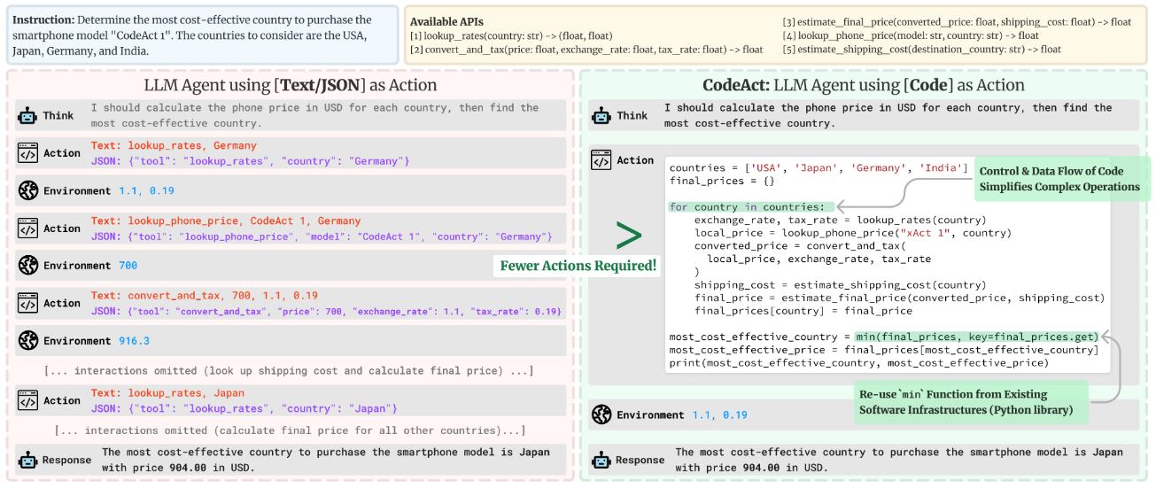





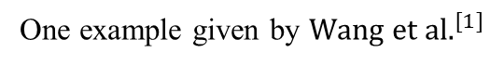
Motivation
Prior ${work}^{[1]}$ demonstrates the advantage of executable code as agent's action over text or JSON format.
How about using pseudocode to represent plan?
Pseudocode-style Plan (P-code Plan)
plan
actions
pseudocode
code
One example given by ${\text{Wang} \text{et} \text{al}\text{.}}^{[1]}$
[1] Wang X, Chen Y, Yuan L, et al. Executable code actions elicit better llm agents. ICML 2024.
Notes:
Prior work demonstrates the advantage of executable code as agent's action over text or JSON format. Inspired by this, we explore using pseudocode to represent plan, given that plans can be considered as high-level abstraction of actions while pseudocode outlines code.

Slide 4
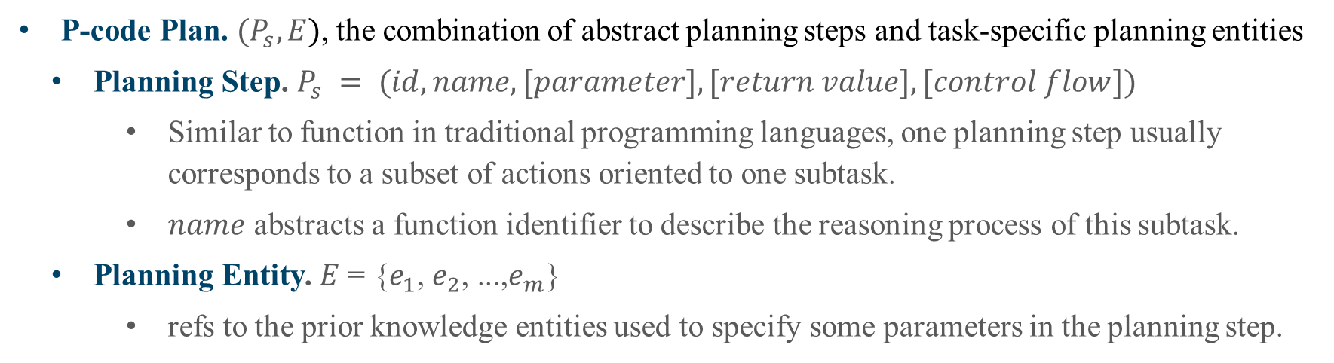
Definition of P-code Plan
P-code Plan. $(P_{s},E)$, the combination of abstract planning steps and task-specific planning entities
Planning Step. $P_{s} = (id, name, [parameter], [return value], [control flow])$
Similar to function in traditional programming languages, one planning step usually corresponds to a subset of actions oriented to one subtask.
$name$ abstracts a function identifier to describe the reasoning process of this subtask.
Planning Entity. $E\text{ = \{}e_{1}\text{,} e_{2}\text{, ...,}e_{m}\text{\}}$
refs to the prior knowledge entities used to specify some parameters in the planning step.
Task Instruction:
P-code Plan:
You are in the middle of a room. Looking quickly around you, you see a cabinet 10, a cabinet 9, a cabinet 8, a cabinet 7, a cabinet 6, a cabinet 5, a cabinet 4, a cabinet 3, a cabinet 2, a cabinet 1, a coffeemachine 1, a countertop 1, a diningtable 1, a drawer 2, a drawer 1, a fridge 1, a garbagecan 1, a microwave 1, a sinkbasin 1, a stoveburner 4, a stoveburner 3, a stoveburner 2, a stoveburner 1, and a toaster 1.
Your task is to: heat some apple and put it in diningtable.
Abstract planning steps:
Step 1. obj_name, loc=locate_object(candidate_locs);
Step 2. take(obj_name, loc);
Step 3. go_to(microwave);
Step 4. heat(obj_name, microwave);
Step 5. go_to(diningtable);
Step 6. put(obj_name, diningtable).
Task-specific entities:
object = apple
candidate_locs = fridge 1, cabinets
Notes:
Our work starts by defining the structural representation of pseudocode-style plans, we call it P-code Plans, which is combined with two parts. First, similar to function in programming languages, planning step corresponds to the subset of actions, uniquely identified by id. name with parameters abstracts a function identifier to describe the reasoning process of this subtask. Square brackets ([...]) mean optional attributes. If necessary, return values are indicated on the left of the assignment operator, standing for the observed information. control flow signifies standard programming structures such as if-else and for, which can be omitted when planning steps are performed sequentially.
Second, Planning Entity refs to the prior knowledge entities used to specify some parameters in the planning step. These entities serve as guidance for generating valid actions and avoiding aimless exploration.
It can be seen that different from NL plans, P-code Plans are more structured and concise.

Slide 5
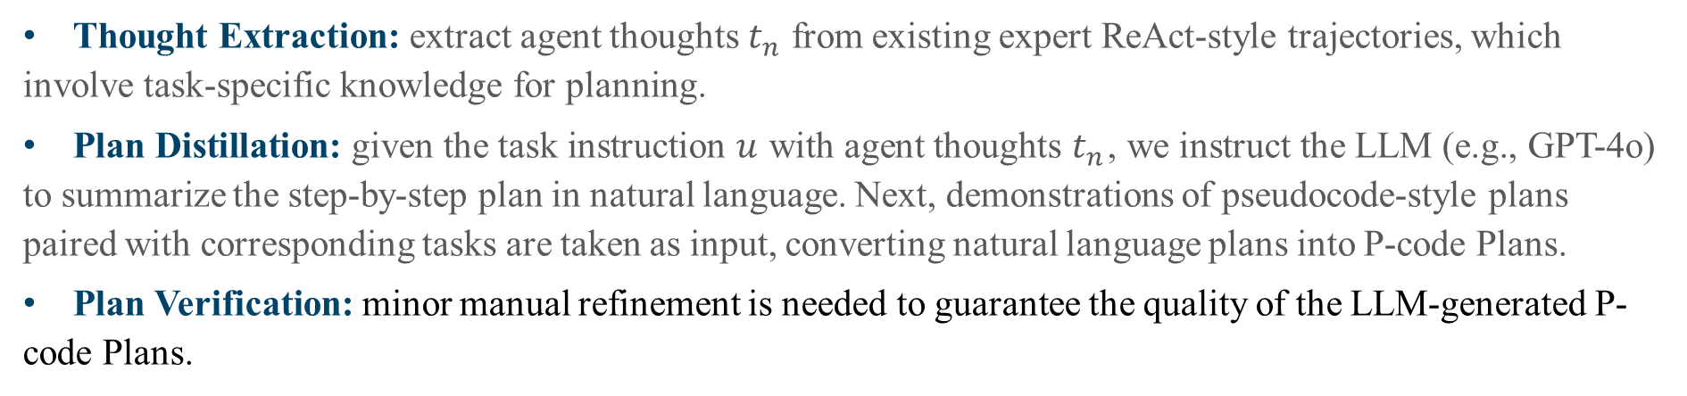
P-code Plan Generation Pipeline
Thought Extraction: extract agent thoughts $t_{n}$ from existing expert ReAct-style trajectories, which involve task-specific knowledge for planning.
Plan Distillation: given the task instruction $u$ with agent thoughts $t_{n}$, we instruct the LLM (e.g., GPT-4o) to summarize the step-by-step plan in natural language. Next, demonstrations of pseudocode-style plans paired with corresponding tasks are taken as input, converting natural language plans into P-code Plans.
Plan Verification: minor manual refinement is needed to guarantee the quality of the LLM-generated P-code Plans.
Notes:
Then, we introduce a plan generation pipeline to obtain P-code Plans. We first extract agent thoughts $t_{n}$ from existing expert ReAct-style trajectories, which involves task-specific knowledge for planning.
Subsequently, given the task instruction $u$ with agent thoughts $t_{n}$, we instruct the LLM (e.g., GPT-4o) to summarize the step-by-step plan in natural language. Next, demonstrations of pseudocode-style plans paired with corresponding tasks are taken as input, converting natural language plans into P-code Plans.
Last, we choose human to verify the LLM-generated P-code Plans whether follow our designed format requirements. In order to guarantee accuracy and knowledge consistency, minor manual refinement are also needed.

Slide 6
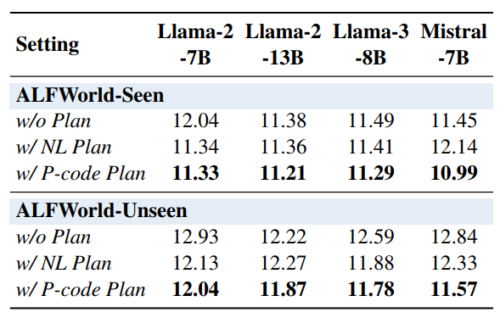
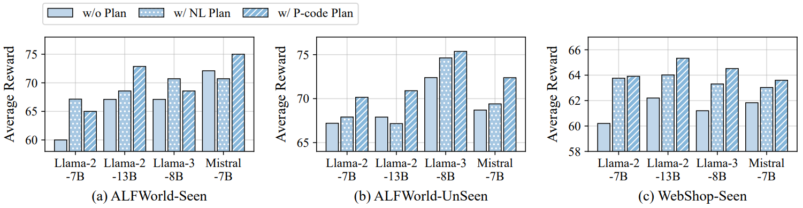
P-code Plan Improves Generalization
We adopt SFT to equip base LLMs with agent abilities and then investigate whether LLM agents can benefit from our designed P-code Plan.
w Plan wo Plan
w P-code Plan w NL Plan
higher average reward (10 out of 12 scenarios)
better generalization to unseen tasks
Fewer average interaction turns
Notes:
The following preliminary experiments are conducted to study the advantage of P-code Plan. We adopt supervised fine-tuning (SFT) to equip base LLMs with agent abilities and then investigate whether LLM agents can benefit from our designed pseudocode-style plans. Compared to naive expert trajectories without plans, integrating plans into training data (regardless of format) empowers LLM agents with basic planning ability, which is beneficial to the following agent reasoning. Regarding planning format, with the help of P-code Plans, agent achieves higher average reward and better generalizes to unseen tasks.
Moreover, we further calculate the average number of interaction turns on all evaluated instances. P-code Plan facilitates a more efficient agent reasoning process with fewer interactions compared to the other two settings. This underscores the superiority of P-code Plan in preventing blind exploration when dealing with agent tasks.

Slide 7
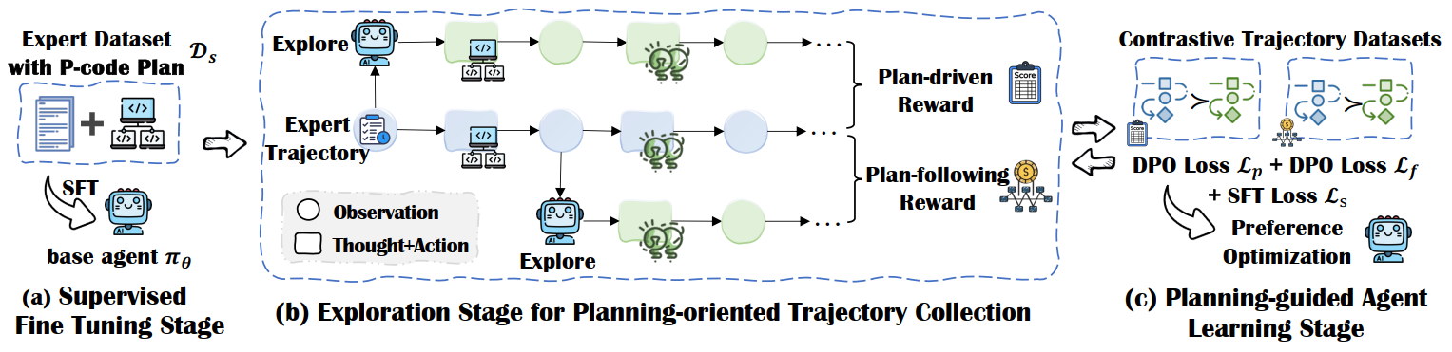
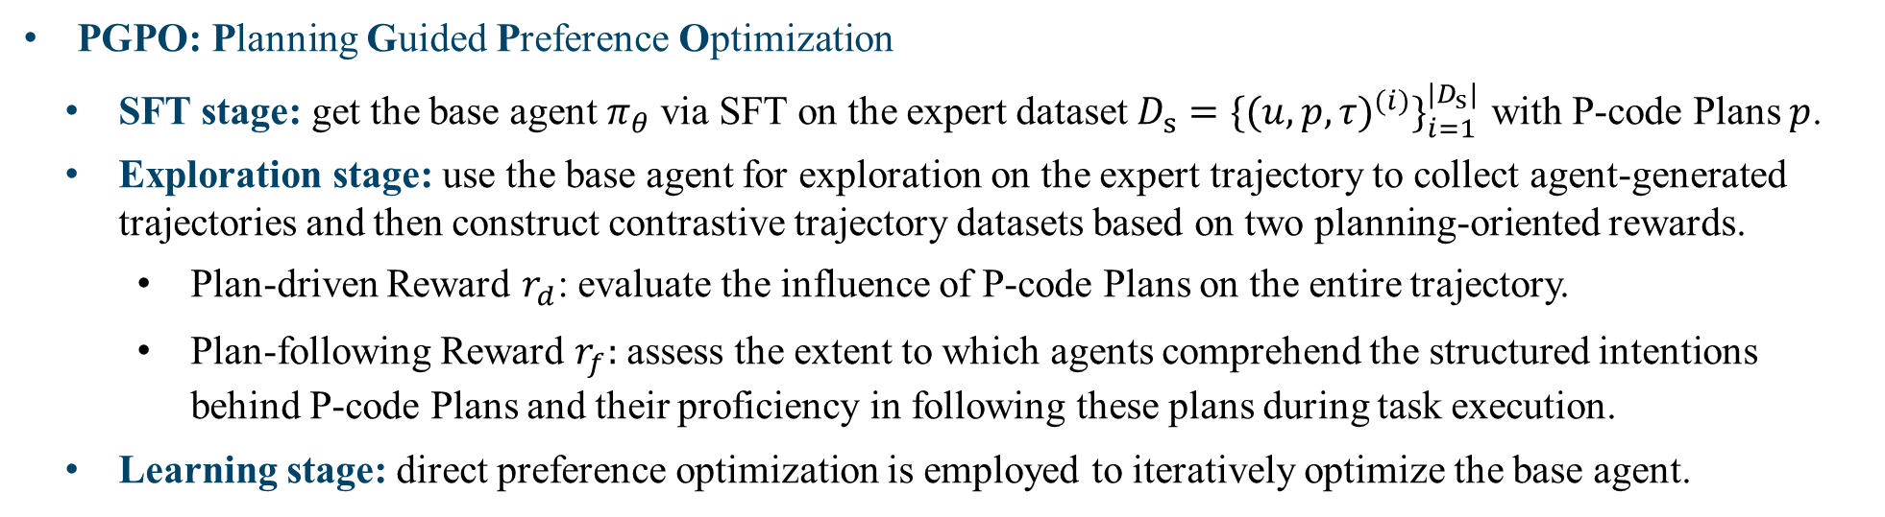
P-code Plan-Guided Agent Learning: PGPO
PGPO: Planning Guided Preference Optimization
SFT stage: get the base agent $π_{θ}$via SFT on the expert dataset $D_{s}={\{{(u,p,τ)}^{(i)}\}}_{i=1}^{{|D}_{s}|}$ with P-code Plans $p$.
Exploration stage: use the base agent for exploration on the expert trajectory to collect agent-generated trajectories and then construct contrastive trajectory datasets based on two planning-oriented rewards.
Plan-driven Reward $r_{d}$: evaluate the influence of P-code Plans on the entire trajectory.
Plan-following Reward $r_{f}:$ assess the extent to which agents comprehend the structured intentions behind P-code Plans and their proficiency in following these plans during task execution.
Learning stage: direct preference optimization is employed to iteratively optimize the base agent.
Notes:
Last, we propose a method for improving agents’ pseudocode-style planning ability, called PGPO, standing for Planning Guided Preference Optimization.
It starts off training the base agent via SFT on the expert dataset with P-code Plans incorporated.
The obtained base agent is used for exploration on the expert trajectory to collect agent-generated trajectories.
Oriented towards planning, we design two rewards for contrastive trajectory construction: 1) Plan-driven Reward evaluates the influence of P-code Plans on the entire trajectory.
2) Plan-following Reward assesses the extent to which agents comprehend the structured intentions behind P-code Plans and their proficiency in following these plans during task execution. After collecting preference data, DPO method is employed to iteratively optimize our base agent.

Slide 8
Experimental Setup
Datasets:
(1) ALFWorld for embodied household tasks
(2) WebShop for online shopping
(3) TextCraft for text games (crafting Minecraft recipes)
Evaluation Metrics: Average Reward
ALFWorld and TexCraft provide binary rewards to indicate task success while WebShop provides dense rewards from 0 to 1 to measure the task completion level.
Baselines:
Training-based methods:
(1) ETO (Song et al., 2024) applies DPO loss to improve the agent from its exploration failures;
(2) IPR (Xiong et al., 2024) introduces step-wise process supervision into LLM agent training.
Training-free methods:
GPT-3.5-Turbo and GPT-4, utilizing two prompt-based methods ReAct (Yao et al., 2023) and ADaPT (Prasad et al., 2024) for comparison.
Backbone Models:
(1) Llama-2-7B/13B
(2) Llama-3-8B
(3) Mistral-7B-v0.1
Notes:
Now, let’s move on to the evaluation of our method.
Our experiments focus on three representative agent benchmarks: ALFWorld for embodied household tasks, WebShop for online shopping and TextCraft for text games.
ALFWorld and TexCraft provide binary rewards to indicate task success while WebShop provides dense rewards from 0 to 1 to measure the task completion level. Thus, for all datasets, we choose the average reward as evaluation metric.
We compare PGPO with naive SFT and other two leading agent learning methods ETO and IPR.
For fair comparison, we also select Llama-2-7B/13B, Llama-3-8B and Mistral-7B-v0.1 as backbone models and use the same training data.
Additionally, we include two strong closed-source LLMs: GPT-3.5-Turbo and GPT-4, utilizing two prompt-based methods ReAct and ADaPT for comparison.

Slide 9
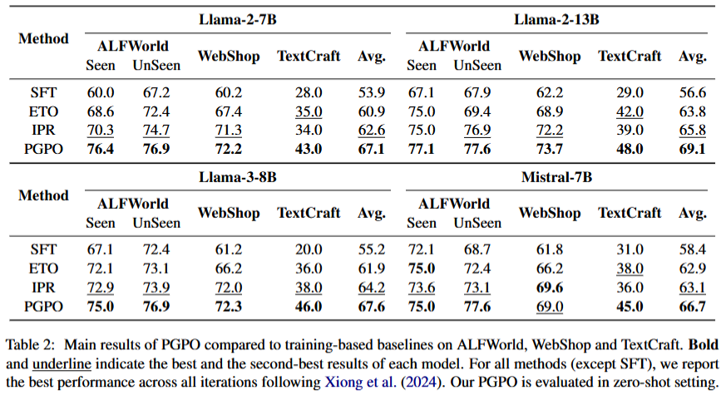
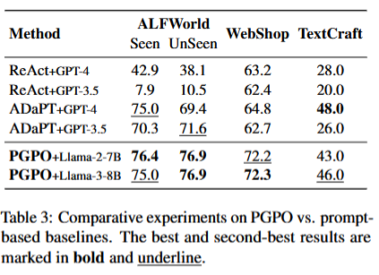


Main Results
Compared with training-based baselines, PGPO significantly increases the average reward across all the datasets. Specifically, PGPO with Llama-2-7B surpasses the state-of-the-art method IPR by an improvement of 7.2% on average reward.
PGPO+Llama-3-8B alleviates the need for few-shot context and achieves comparable or even better results.
Notes:
Overall, PGPO significantly increases the average reward across all the datasets. Specifically, PGPO with Llama-2-7B surpasses the state-of-the-art method IPR by an improvement of 7.2% on average reward. Moreover, via our PGPO, smaller open-source model-based agents can rival or exceed the agent capabilities of strong closed-source models, alleviating the need for few-shot context.

Slide 10
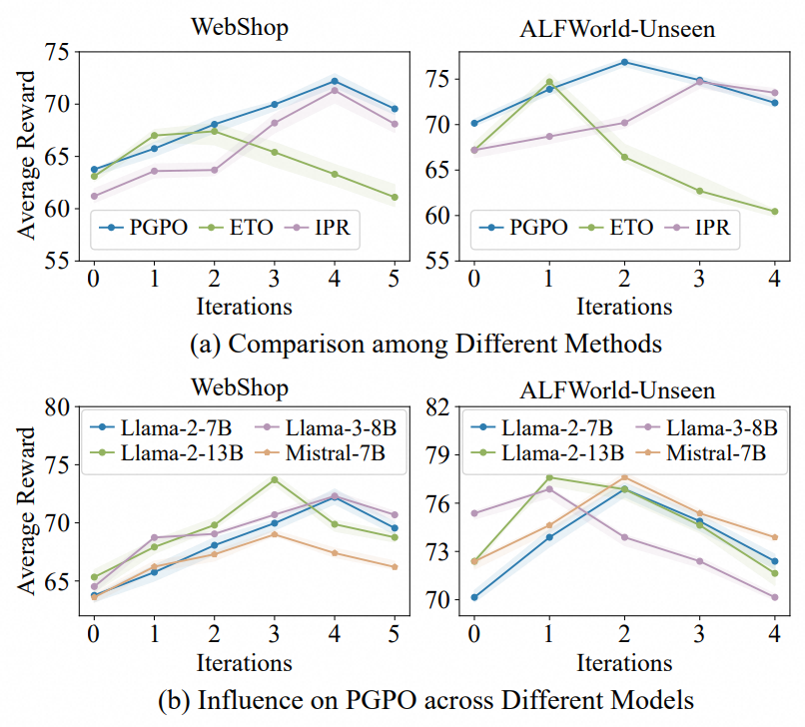
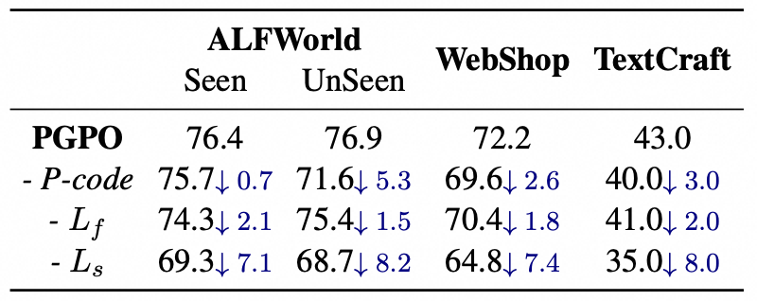

Ablation Study
Approach Ablations
Ablation on Optimization Iterations
The most significant performance drop comes from the removal of SFT loss.
The performance upper bound brought by P-code Plans is still superior to that of NL plans.
The necessity of using plan-following reward in preference optimization is also demonstrated.
Figure 3: Ablation study on optimization iterations. (a) provides a comparison of the performance of PGPO against ETO and IPR across varying iterations. (b) shows the influence of increasing iterations on PGPO across different base models. iter=0 is the SFT stage.
Table 3: Approach ablations of PGPO. - P-code represents using NL plans to replace P-code Plans. - $L_{f}$ denotes leaving out the estimation of plan-following reward, followed by the removal of $L_{f}$. - $L_{s}$ means the removal of SFT loss.
Notes:
We also explore how the performance of PGPO changes when removing certain key components. The experimental results show that the most significant performance drop comes from the removal of SFT loss.
By replacing P-code Plans with NL plans in training data and then employing PGPO, we also validate that even with subsequent iterative preference optimization, the performance upper bound brought by P-code Plans is still superior to that of NL plans.
Additionally, the necessity of using plan-following reward in preference optimization is also demonstrated.
Moreover, we observe with optimization iterations increase, all methods first exhibit performance improvements and then become worse due to excessive iterations. Among them, PGPO consistently achieves the highest peak performance.
Despite different base models, the peak performance of PGPO can be achieved within 4 iterations. However, the performance variation trend across them quite differs, which reflects the distinct extent of each model grasping the meta-knowledge inherent in P-code Plans.

Slide 11

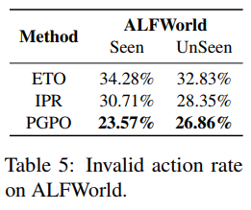
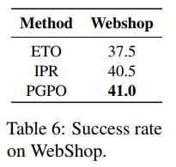
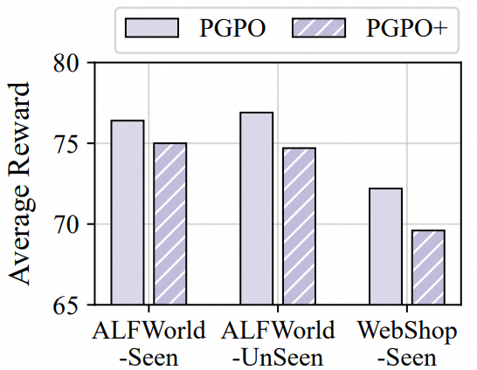
Analysis
invalid action rate
P-code Plan guidance can reduce the incidence of action errors and omissions in reasoning. We calculate the proportion of trajectories containing invalid actions for each method on Llama-2-7B in Table 5. Table 6 shows that PGPO achieves the highest success rate, indicating guidance from P-code Plans indeed reduces the agent’s action omissions.
success rate
&
Step-wise reward does not necessarily elicit better LLM agents. It is still challenging to accurately determine the contribution of the intermediate step, thus introducing step-wise reward instead plays a negative role in agent reasoning.
Notes:
Table 5 presents the proportion of trajectories containing invalid actions for each method on Llama-2-7B.
Table 6 shows that PGPO achieves the highest success rate, indicating guidance from P-code Plans indeed reduces the agent’s action omissions.
We further evaluate whether introducing step-wise reward to our PGPO could further facilitate agent reasoning. As illustrated in lower right figure, step-wise reward negatively impacts the PGPO performance.
We speculate that it is still challenging to accurately determine the contribution of the intermediate step, thus introducing step-wise reward instead plays a negative role in agent reasoning.

Slide 12
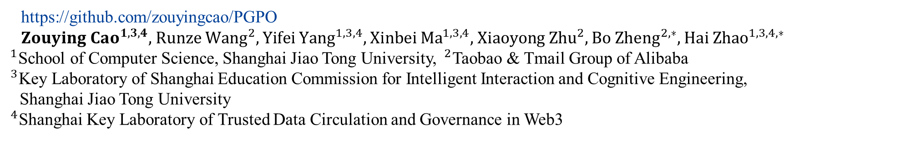
Thank you !
PGPO: Enhancing Agent Reasoning via Pseudocode-style Planning Guided Preference Optimization
https://github.com/zouyingcao/PGPO
${Zouying Cao}^{1,3, 4},$ ${\text{Runze} \text{Wang}}^{2},$ ${Yifei Yang}^{1,3,4},$ ${\text{Xinbei} \text{Ma}}^{1,3,4},$ ${\text{Xiaoyong} \text{Zhu}}^{2},$ ${\text{Bo} \text{Zheng}}^{2,∗},$ ${Hai Zhao}^{1,3,4,∗}$ $^{1}$School of Computer Science, Shanghai Jiao Tong University, $^{2}$Taobao & Tmail Group of Alibaba
$^{3}$Key Laboratory of Shanghai Education Commission for Intelligent Interaction and Cognitive Engineering,
Shanghai Jiao Tong University
$^{4}$Shanghai Key Laboratory of Trusted Data Circulation and Governance in Web3
zouyingcao@sjtu.edu.cn, yunze.wrz@alibaba-inc.com
Notes:
That’s all. Thanks for listening.
It’s my pleasure to share our work.
Thank you.

